Slide 1
How Not to Build a Pi Wars Robot
By Brian Corteil

Slide 2
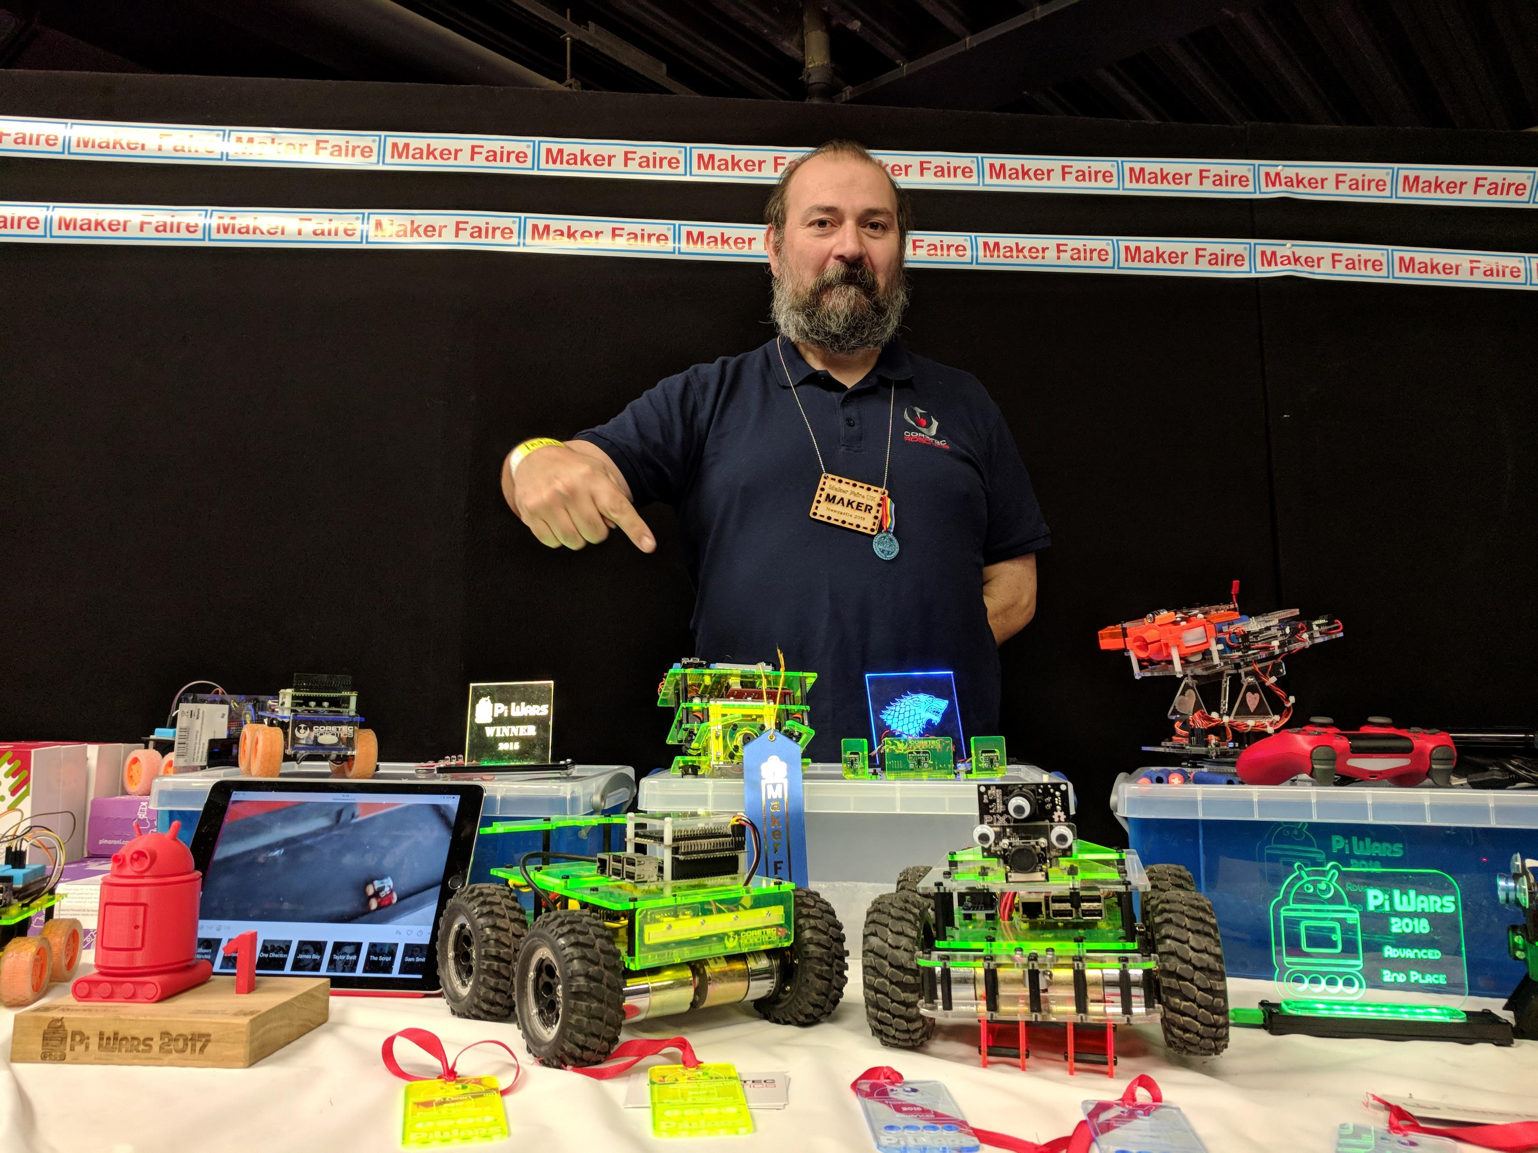
Brian Corteil aka @CannonFodder
Pi Wars History
Year 1: PyroBot, ended up in the bottom third.
Year 2: Revenge, A3 class winner
Year 3: Rover, Pro’s winner
Year 4: MAX, Pro’s runner up of by one point*
Year 5: Face-plant, last place Pro’s
It was a rounding error, not still sore at all!
Twitter: @CannonFodder

Slide 3

Only 175 days to Pi Wars 2020!!!!

Slide 4
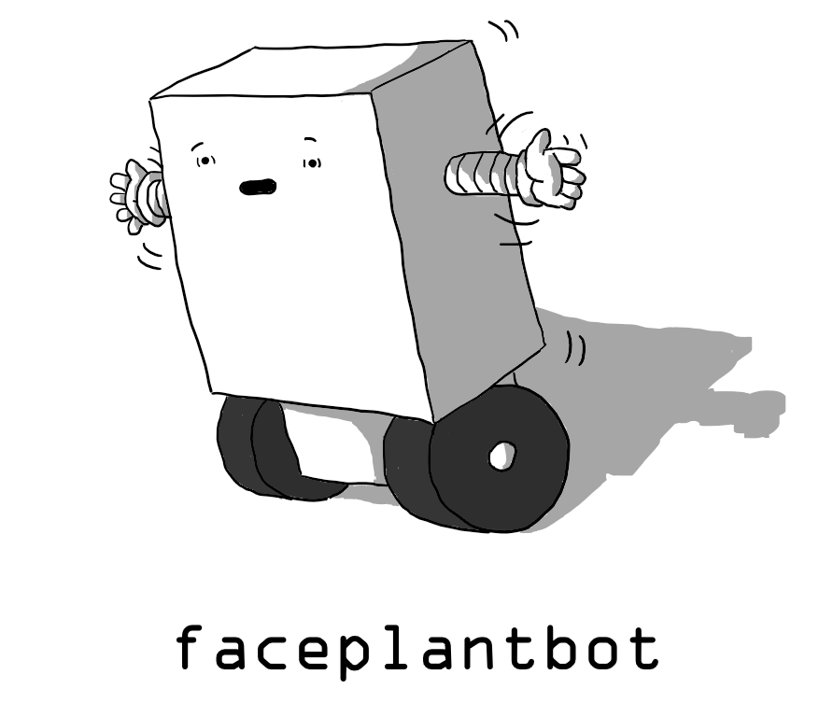

Slide 5
Classic or noob errors
Late starting the programming for the challenges, start before well before Christmas not in February!
No system menu
Make adjustments on the night before
Not enough driving practice
Not testing code
Wrong size of motor driver for motors selected

Slide 6
Too Win or Not too win, that is the question!
Types of robots suitable for a Pi Wars robot or not.
Three wheels
Four wheel drive
Six wheel drive
Caterpillar tracks
Omni directional
Walking
Balance (Two Wheels) – Silly idea!

Slide 7
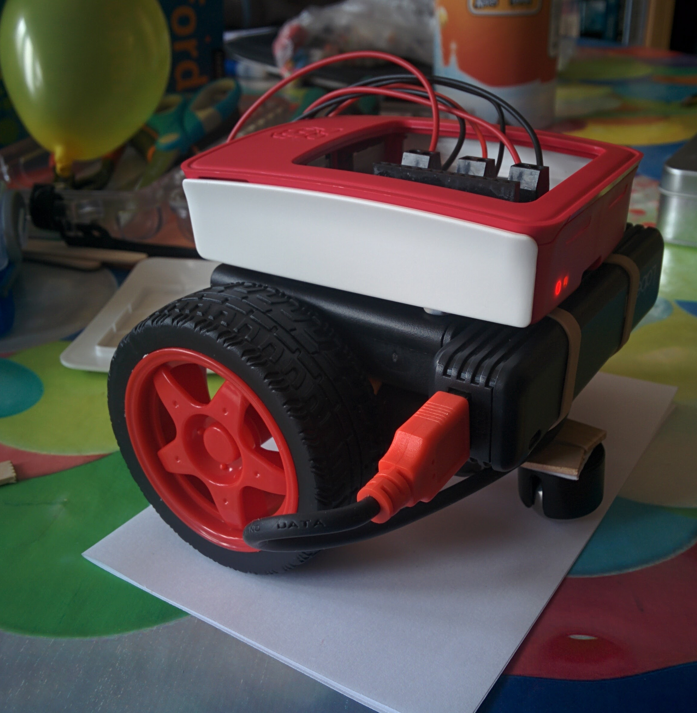
Three Wheels
Simple build
Caster wheels catches on everything
Will find challenges like the obstacle course hard.

Slide 8
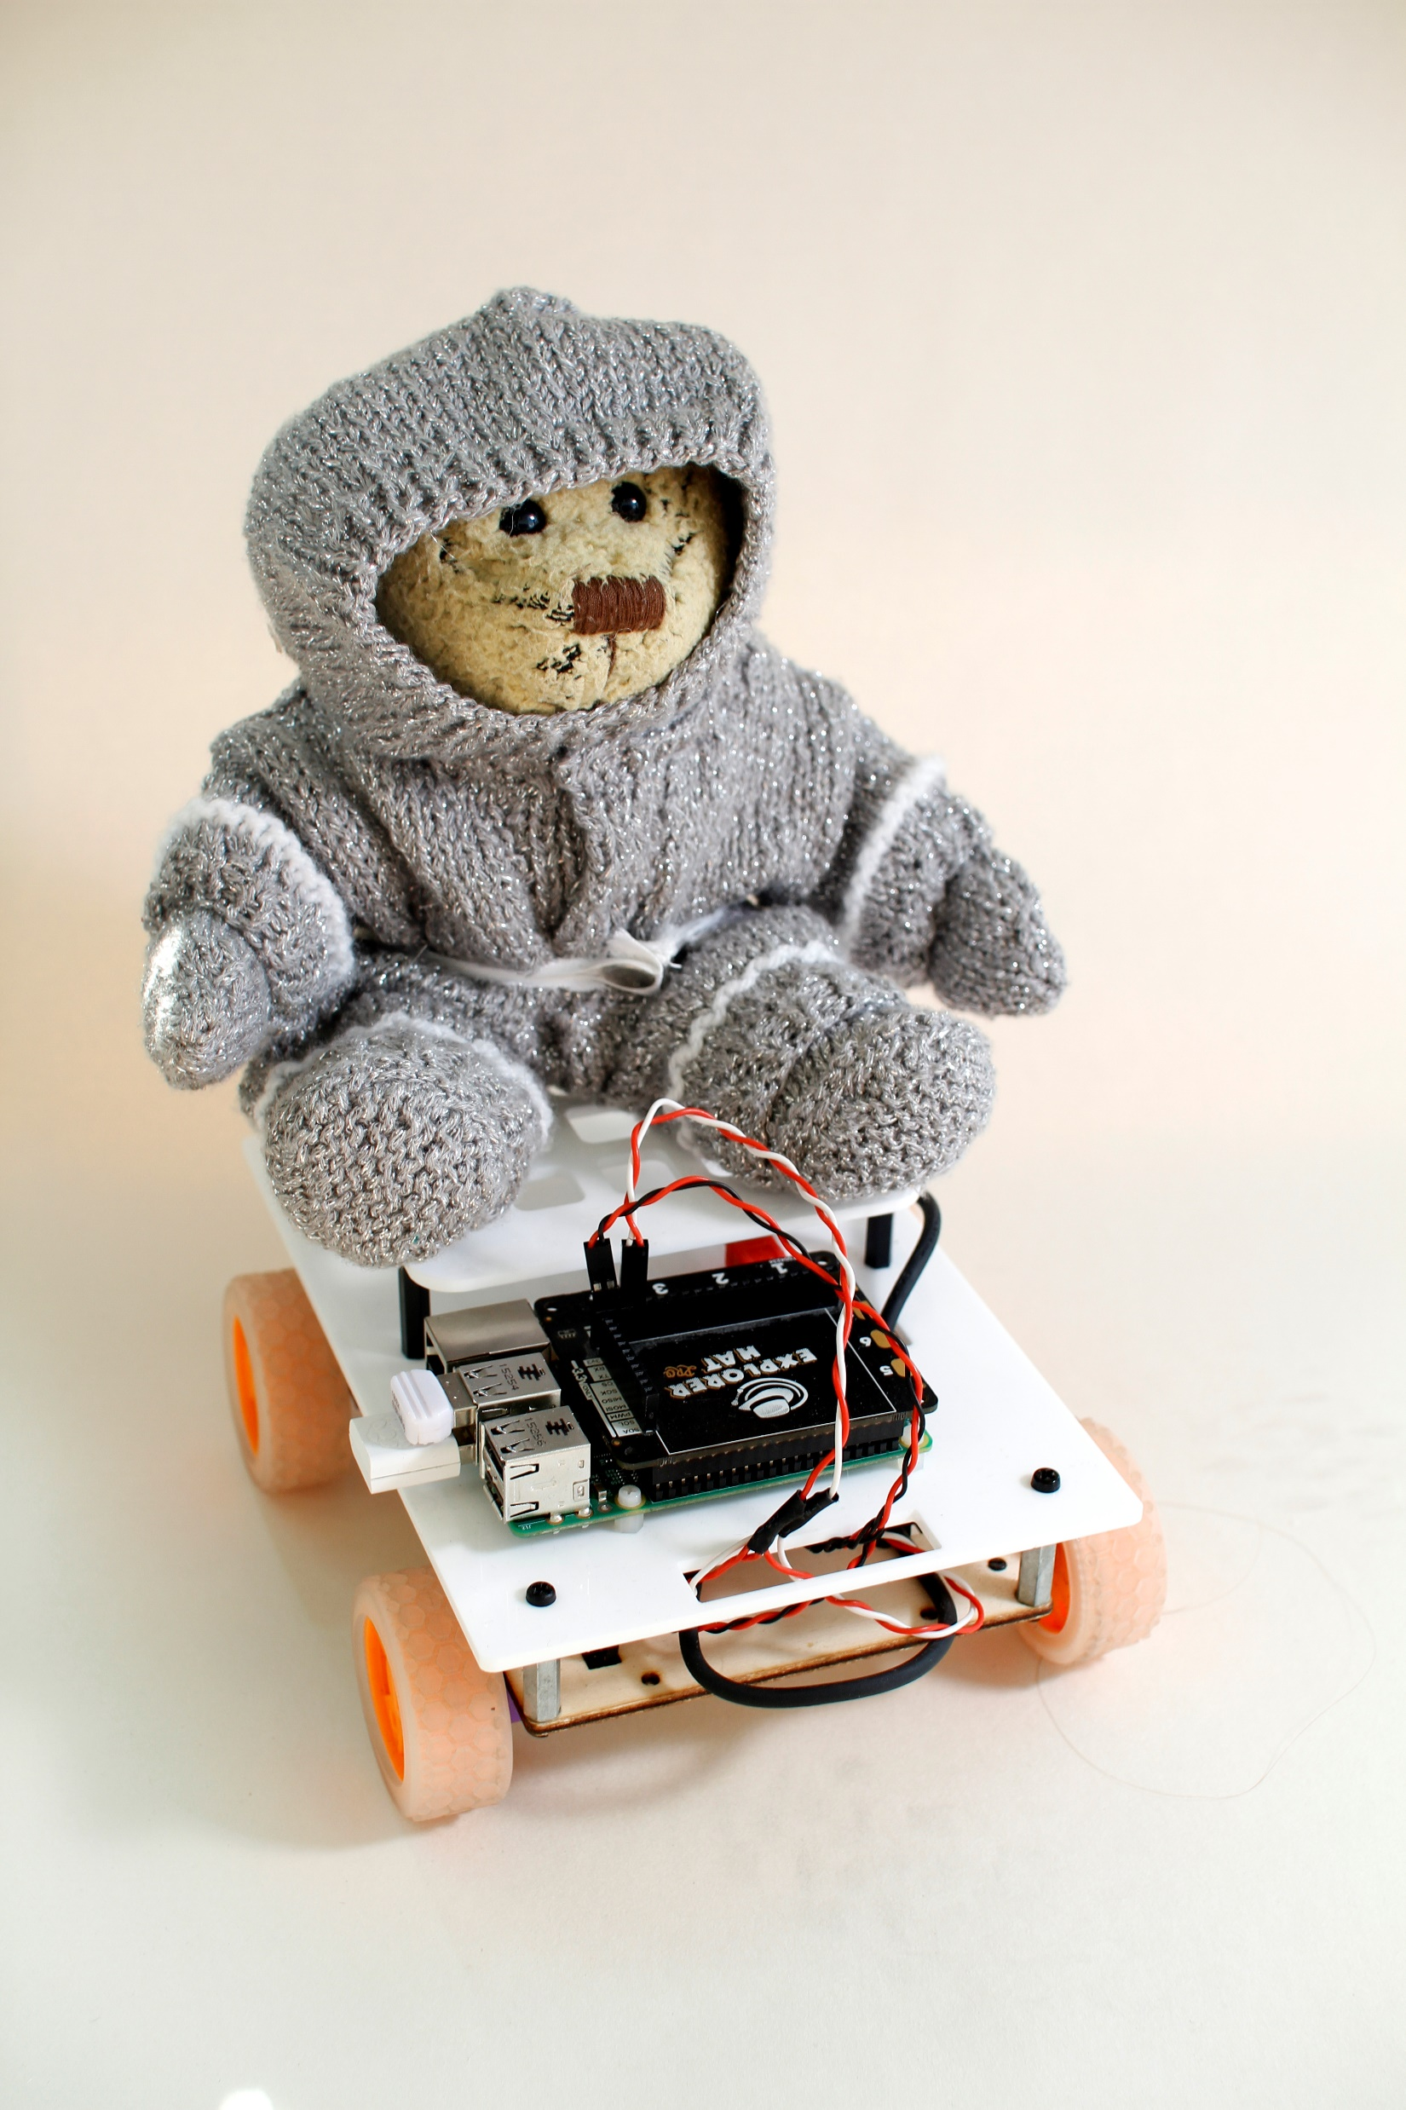
Four Wheel or 4WD
The standard

Slide 9
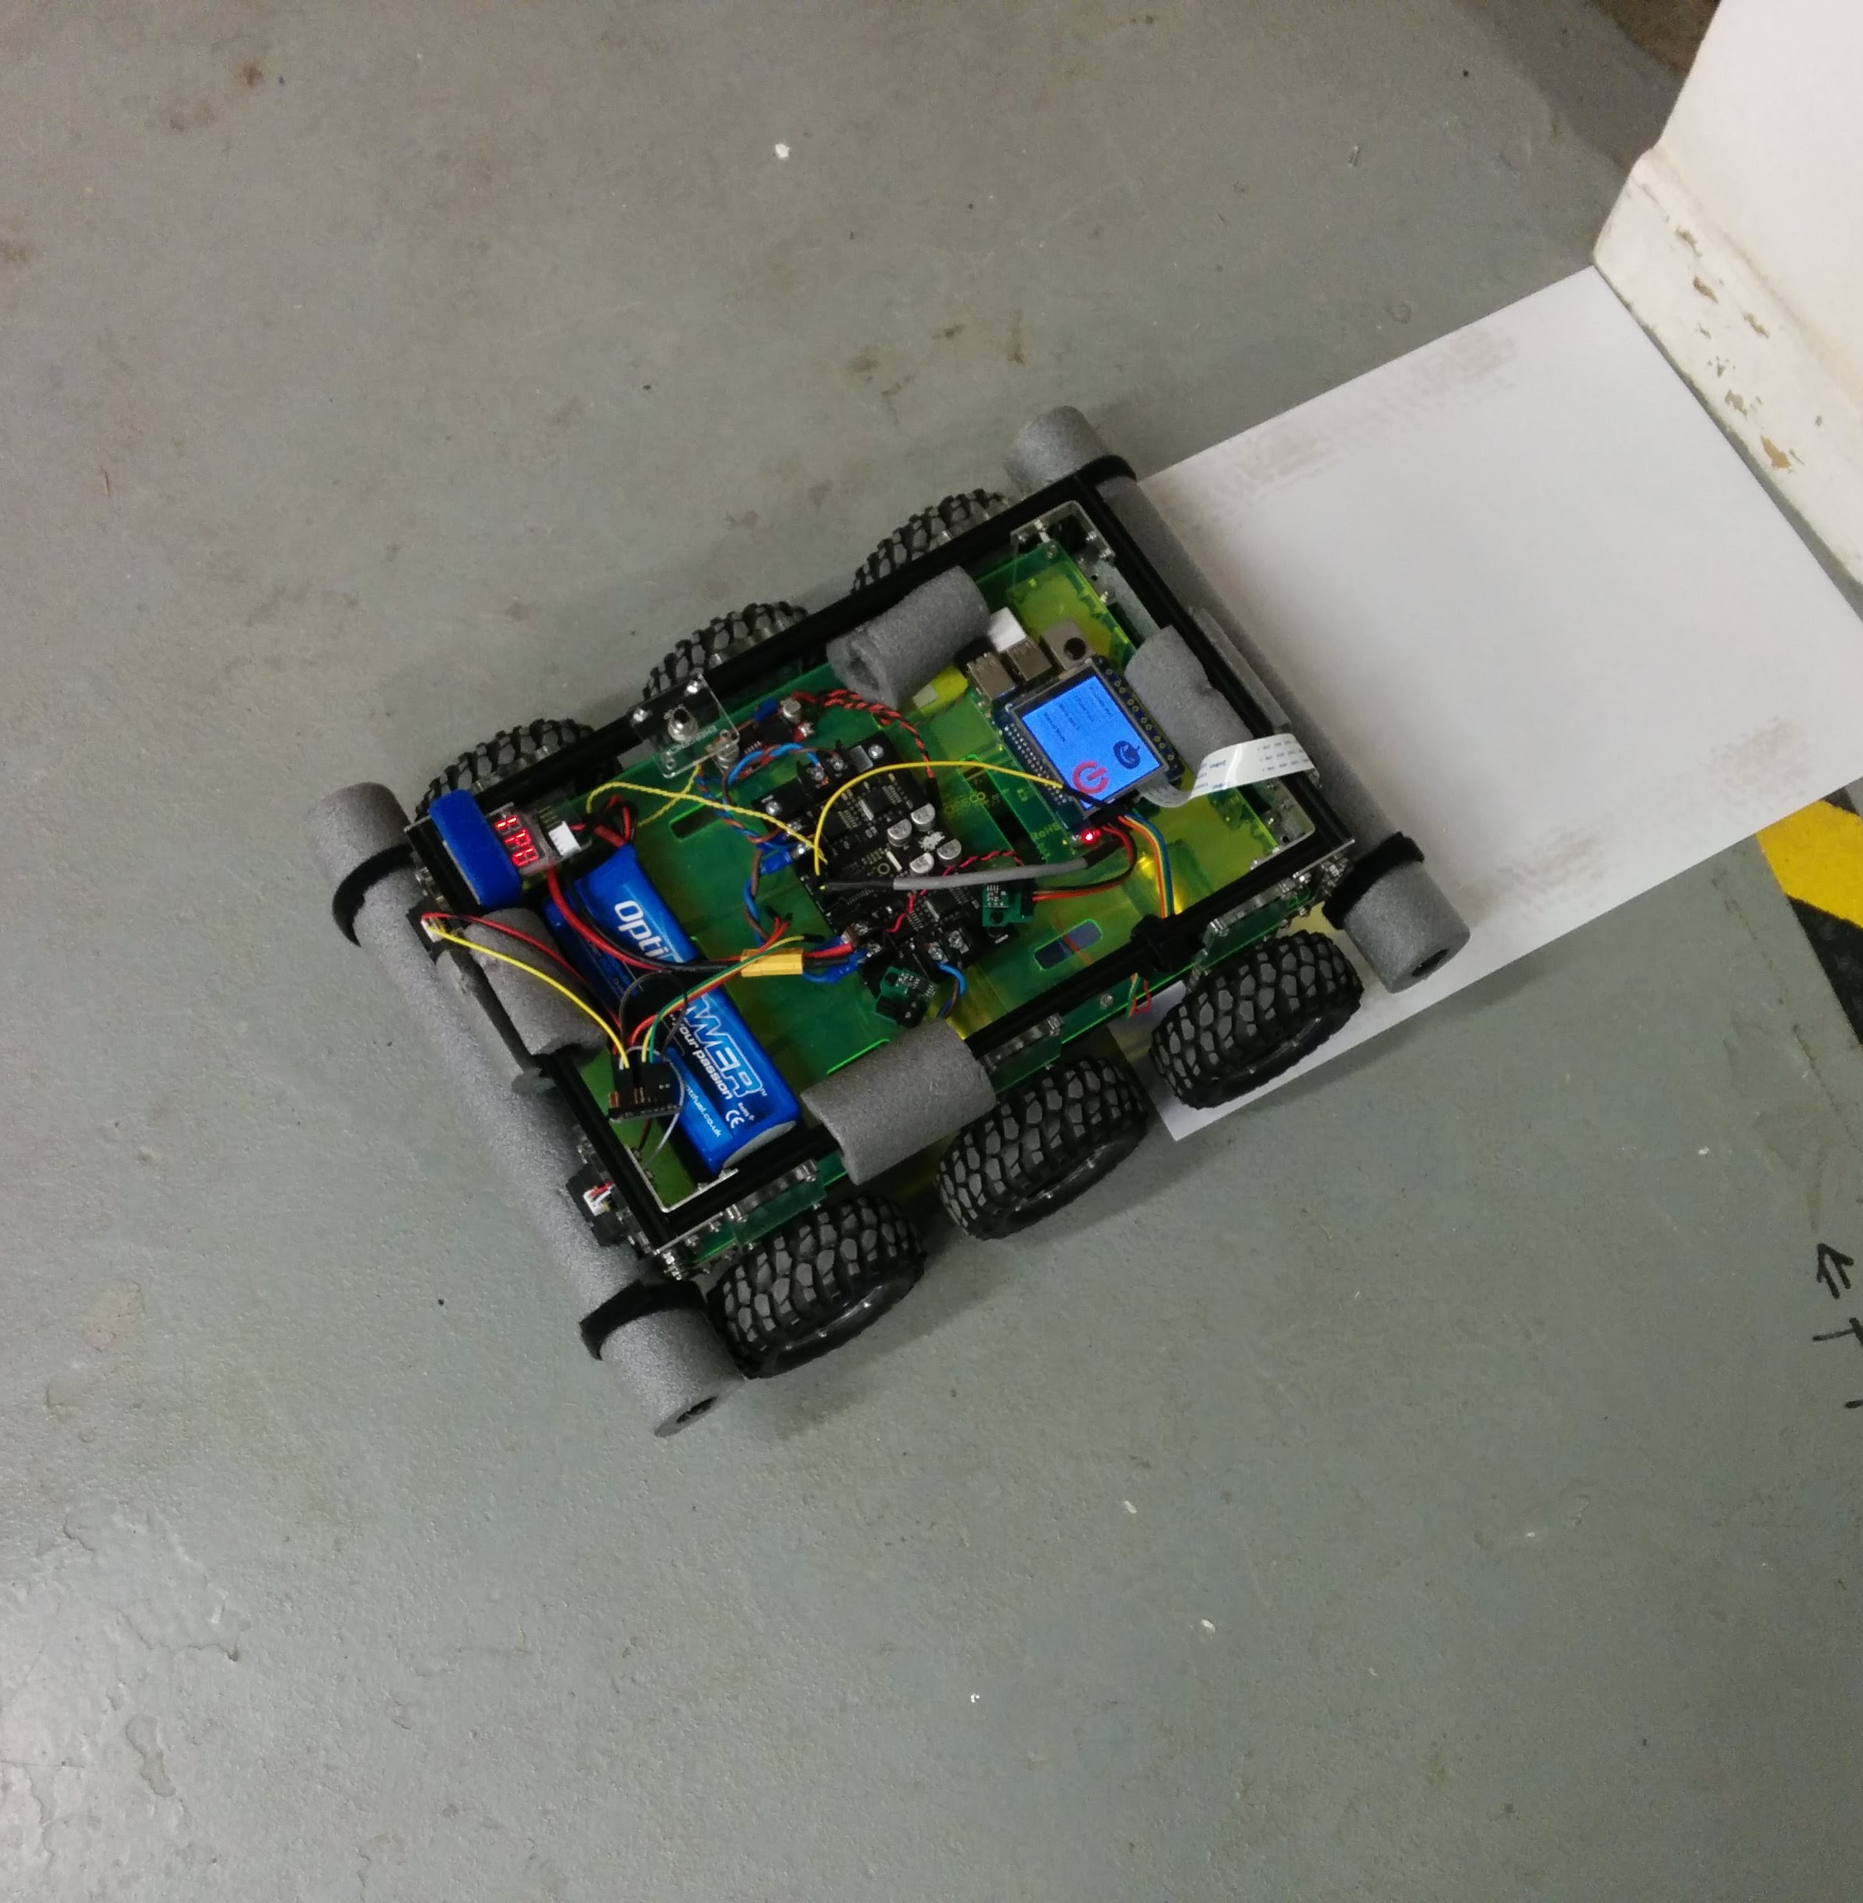
Six Wheel drive
Loads of grip
Behaves like it has tracks

Slide 10
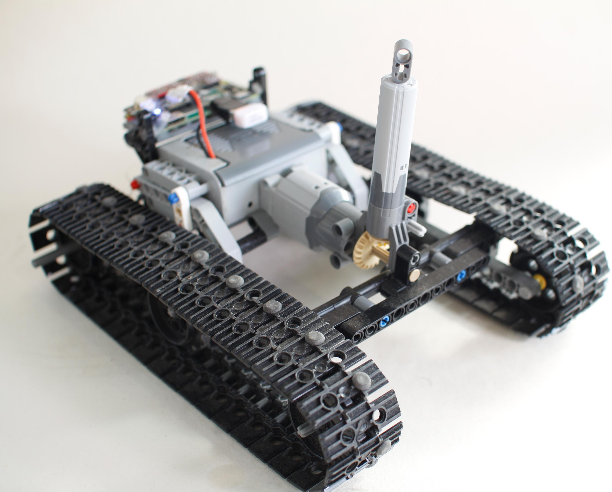
Caterpillar tracks
Good grip
Turns on the spot
Can be tricky to get tracks right

Slide 11
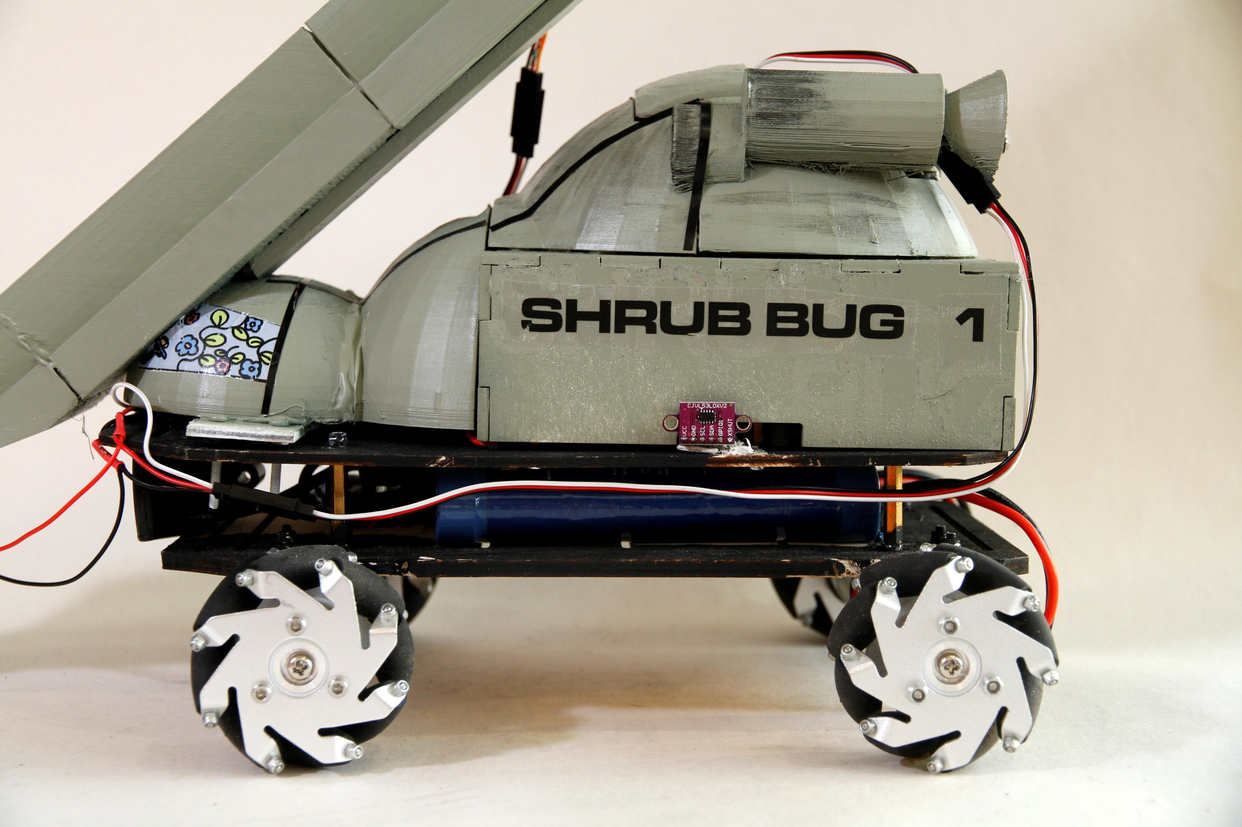
Omni directional
Great on flat services
Highly manoeuvrable, great for Pi Noon.
Will find challenges like the obstacle course hard.

Slide 12

Walking
Slow

Slide 13
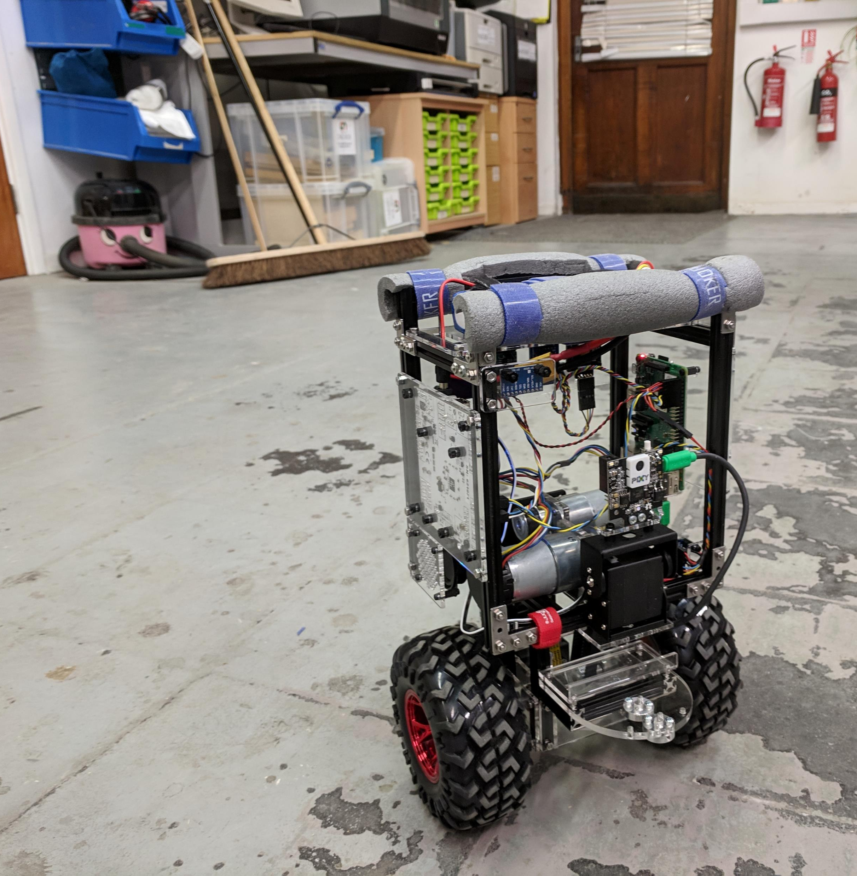
Balance Bot
Silly Idea

Slide 14
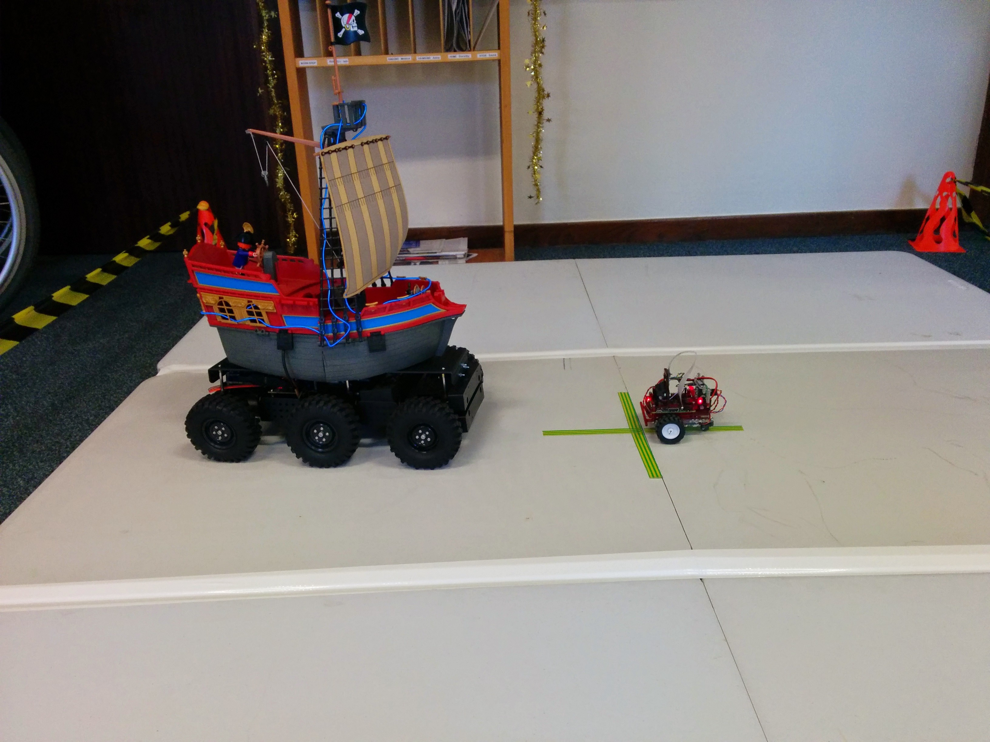
What size?
Large (A4 ish)
Pros: more room for stuff, big meaty motors, large wheels
Cons: needs more room to turn
Small(A5 or less)
Pros: loads of room to turn,
Cons: can’t use big meaty motors, small wheels, less space for stuff.

Slide 15
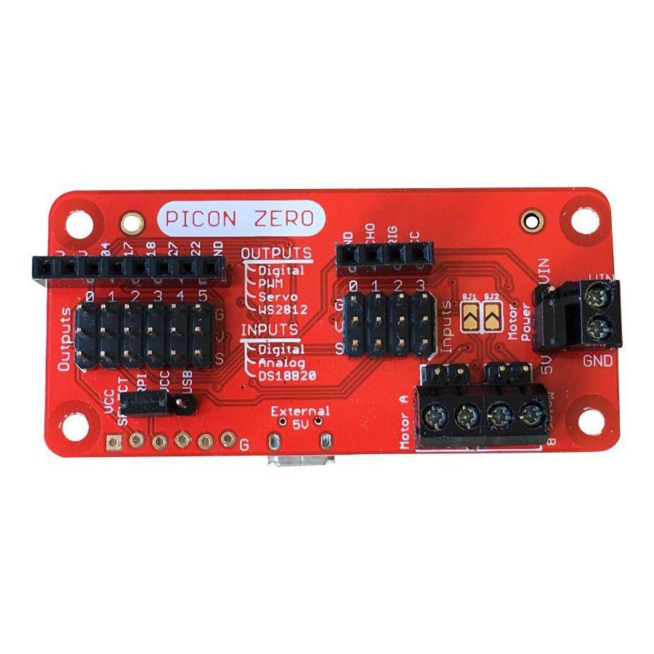
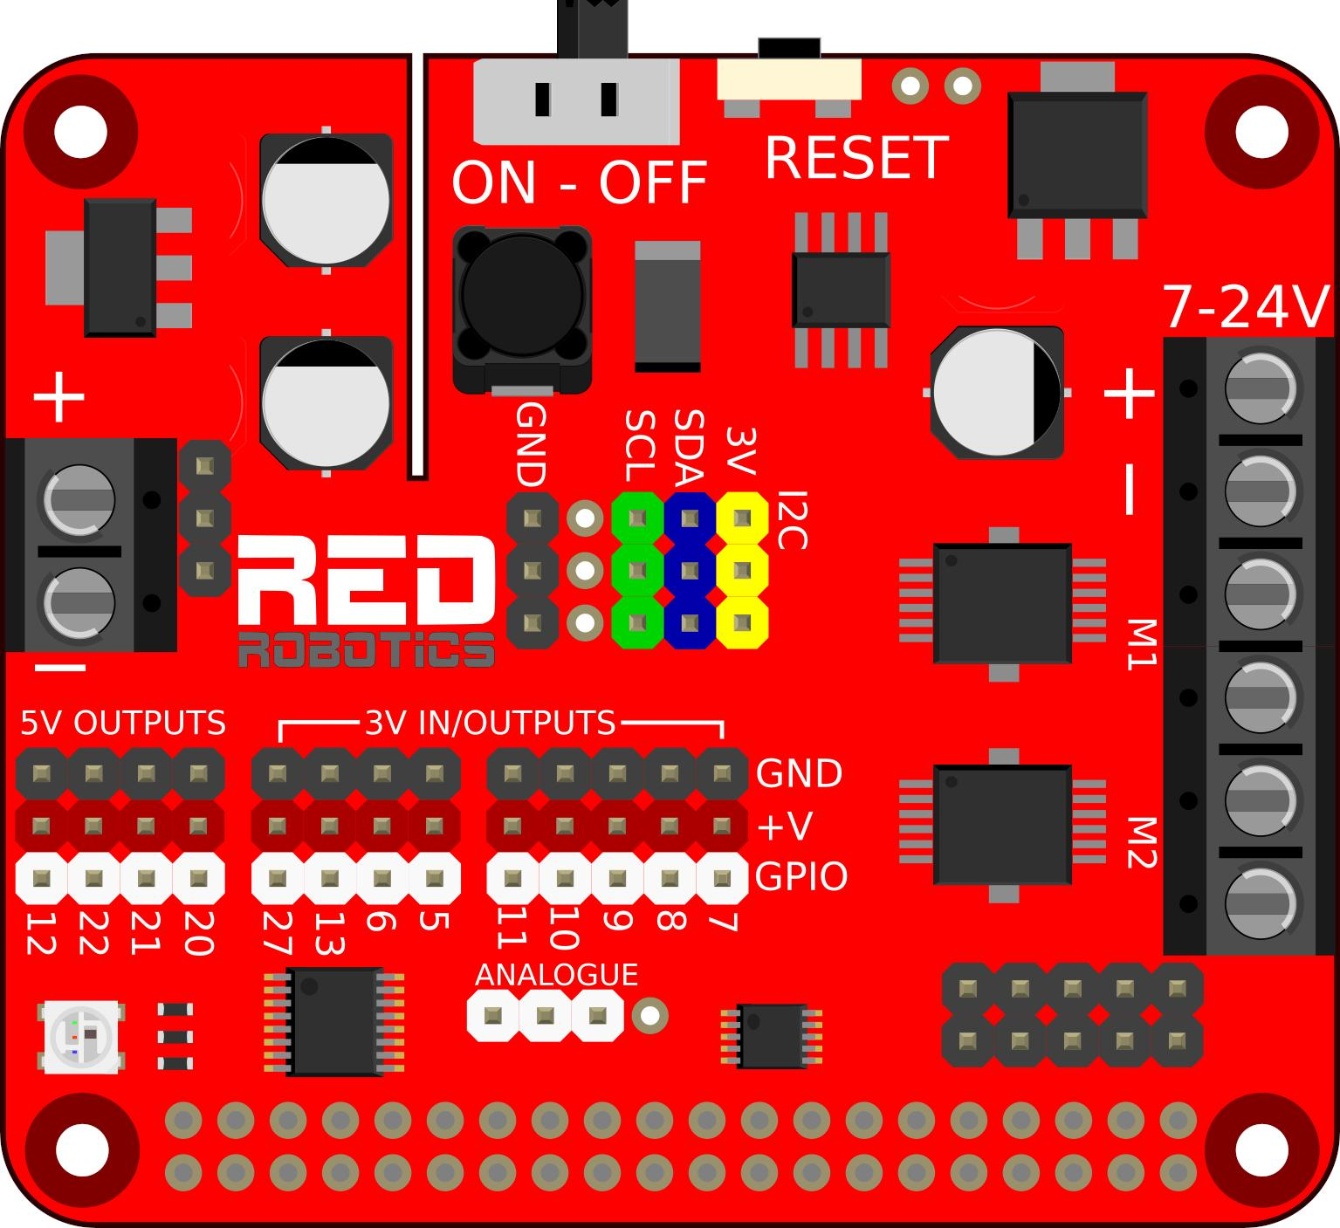
Equipment selection
Motors
Motor driver
Sensors
Sonic
ToF
IR
Camera
Line following

Slide 16
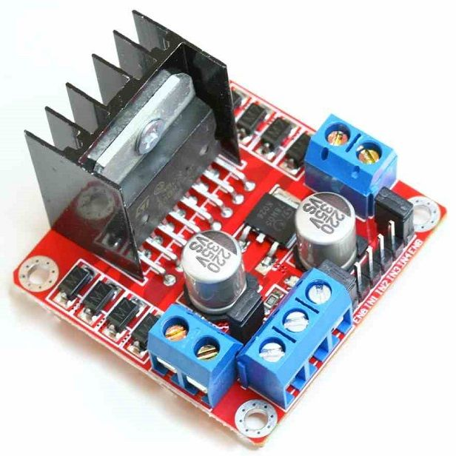
L298N Motor Driver Module
Volt drop on output = less power to motors
Heatsink = lost power to heat

Slide 17
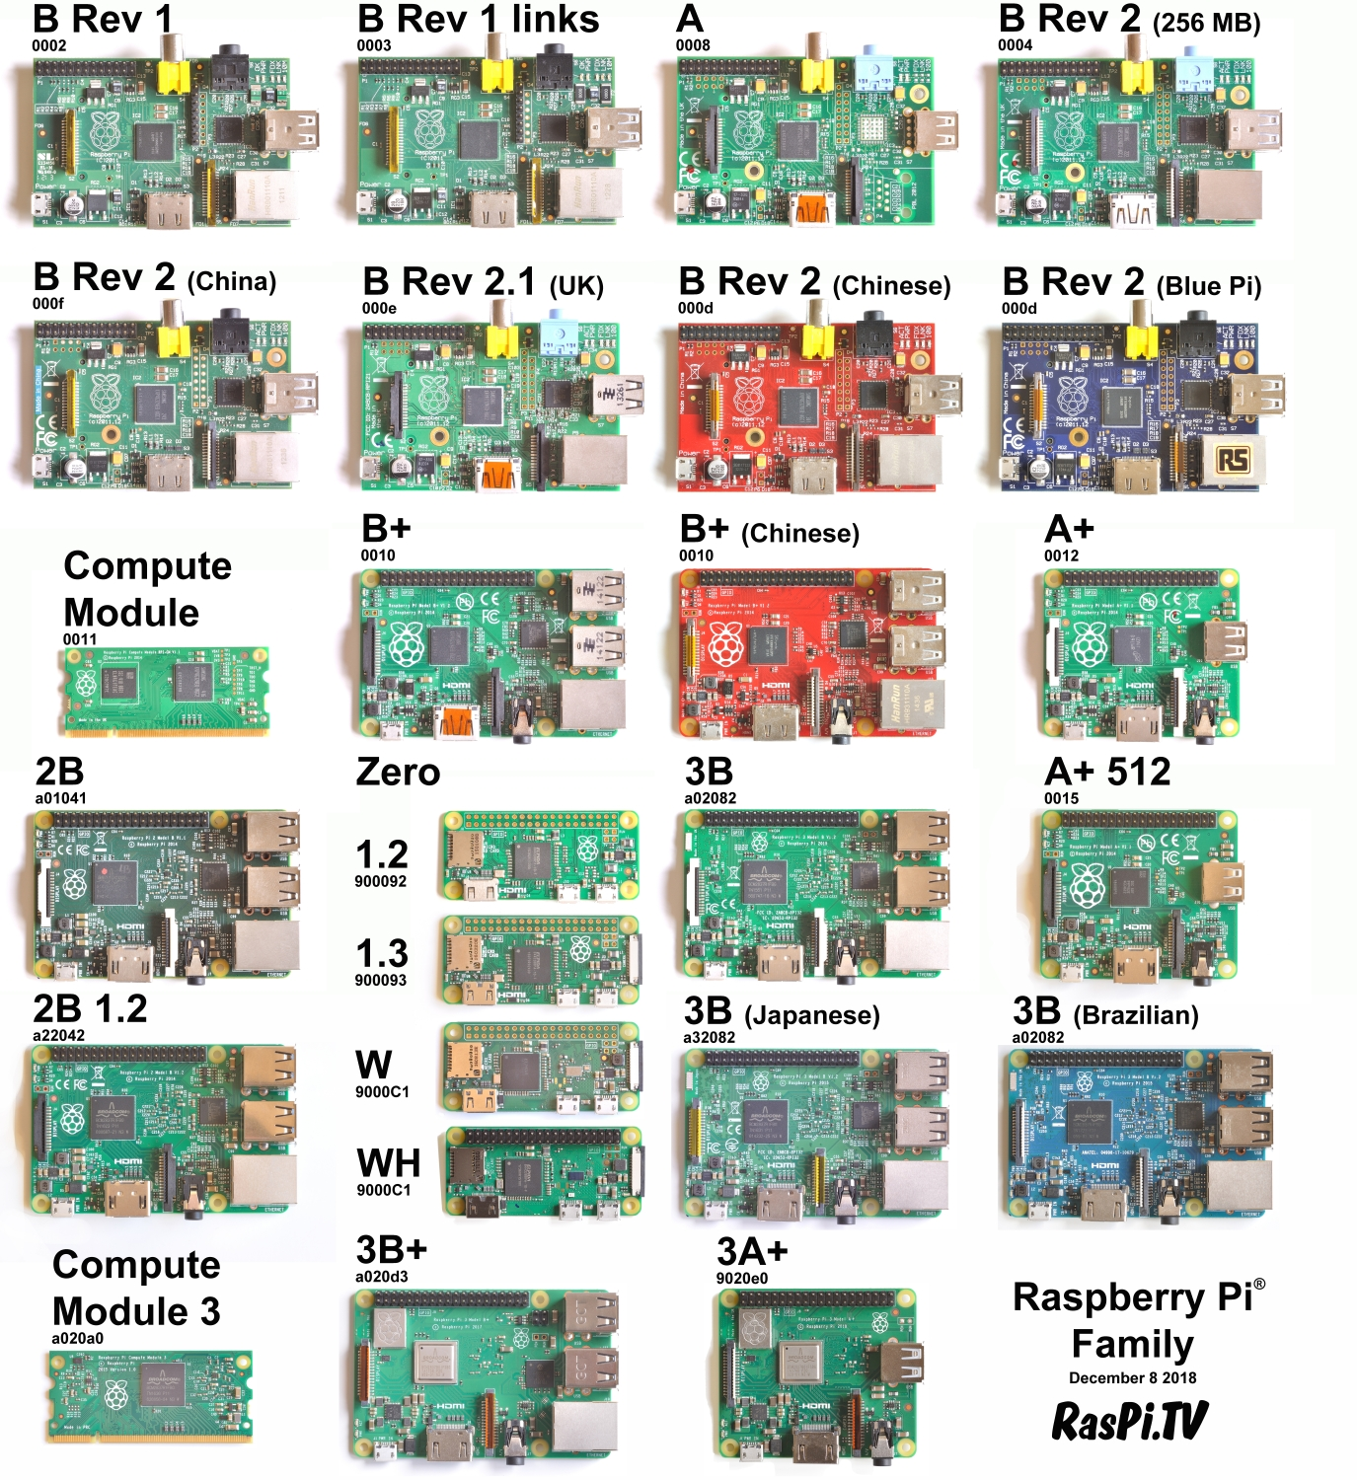
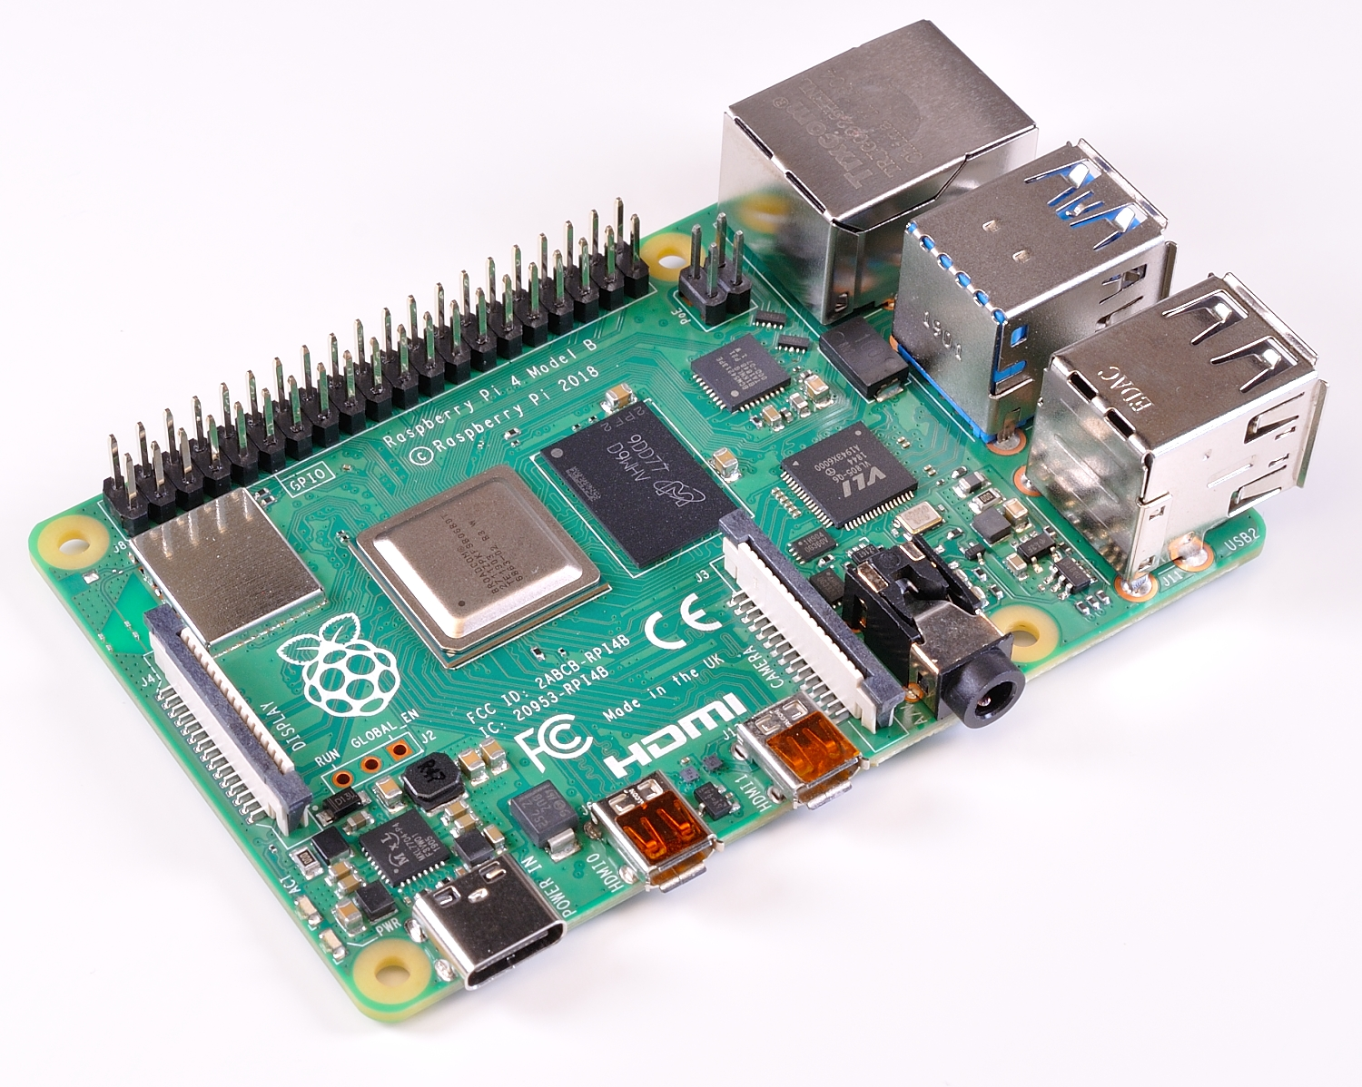

Slide 18
Which Raspberry Pi
Pi Zero for low power requirement
Pi 4 model B for open CV and any other CPU heavy tasks
Pi 3 model A as good all round model

Slide 19
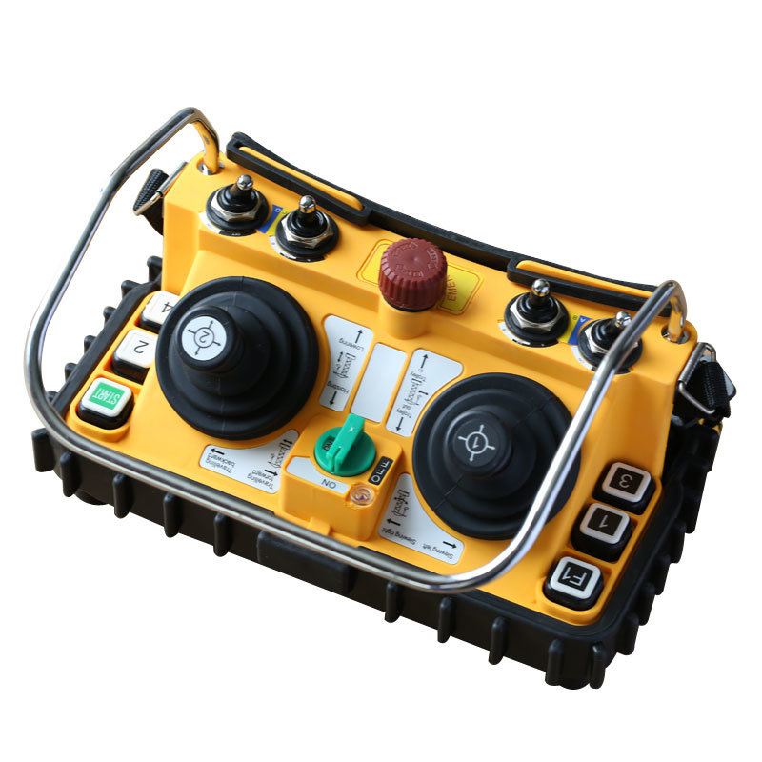
Controls
Wireless Keyboard
Game controller
Bluespot app
Approximant engineering input or Pi Game libraries

Slide 20
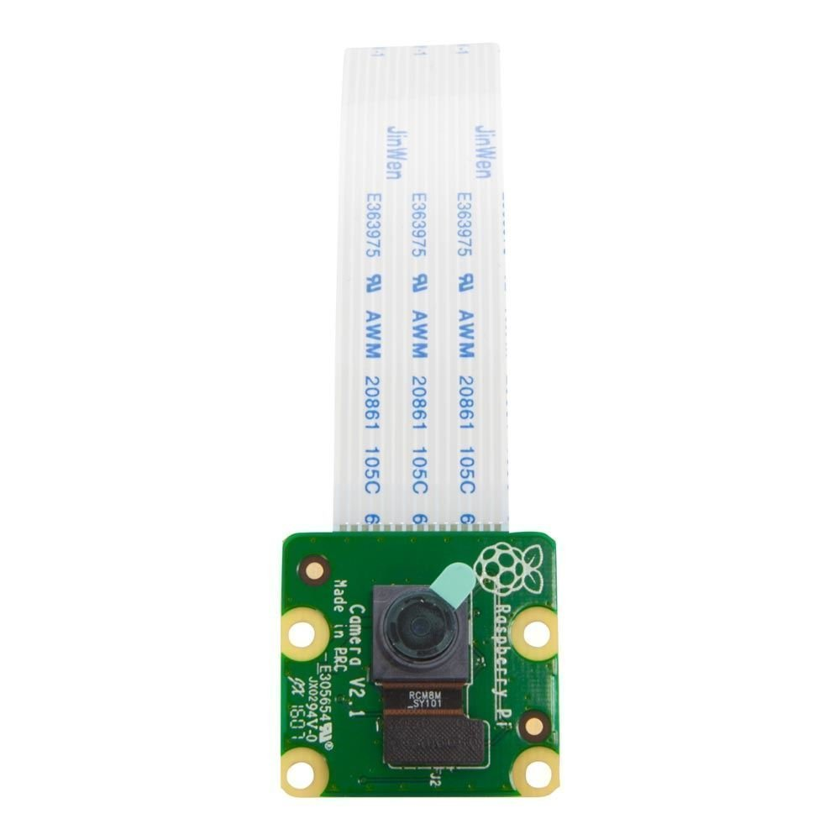
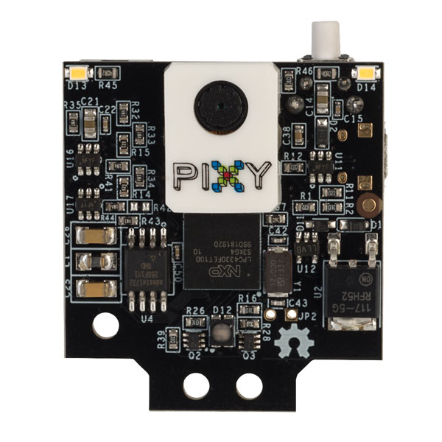
Computer vision
Pi camera
OpenCV
Pixy Camera
no OpenCV

Slide 21
How to collect points and win
Enter everything! there are points for trying
Better to be average across all the challenges than just being the best at one or two.

Slide 22

Build quality
No bread boards use strip or proto board instead
Bird nests are for birds not robots
Make sure batteries are secure
Keep cables tidy
Have a wiring colour scheme

Slide 23

Artistic merit
Have a theme and keep to it
Make it fun and playful
Small details

Slide 24
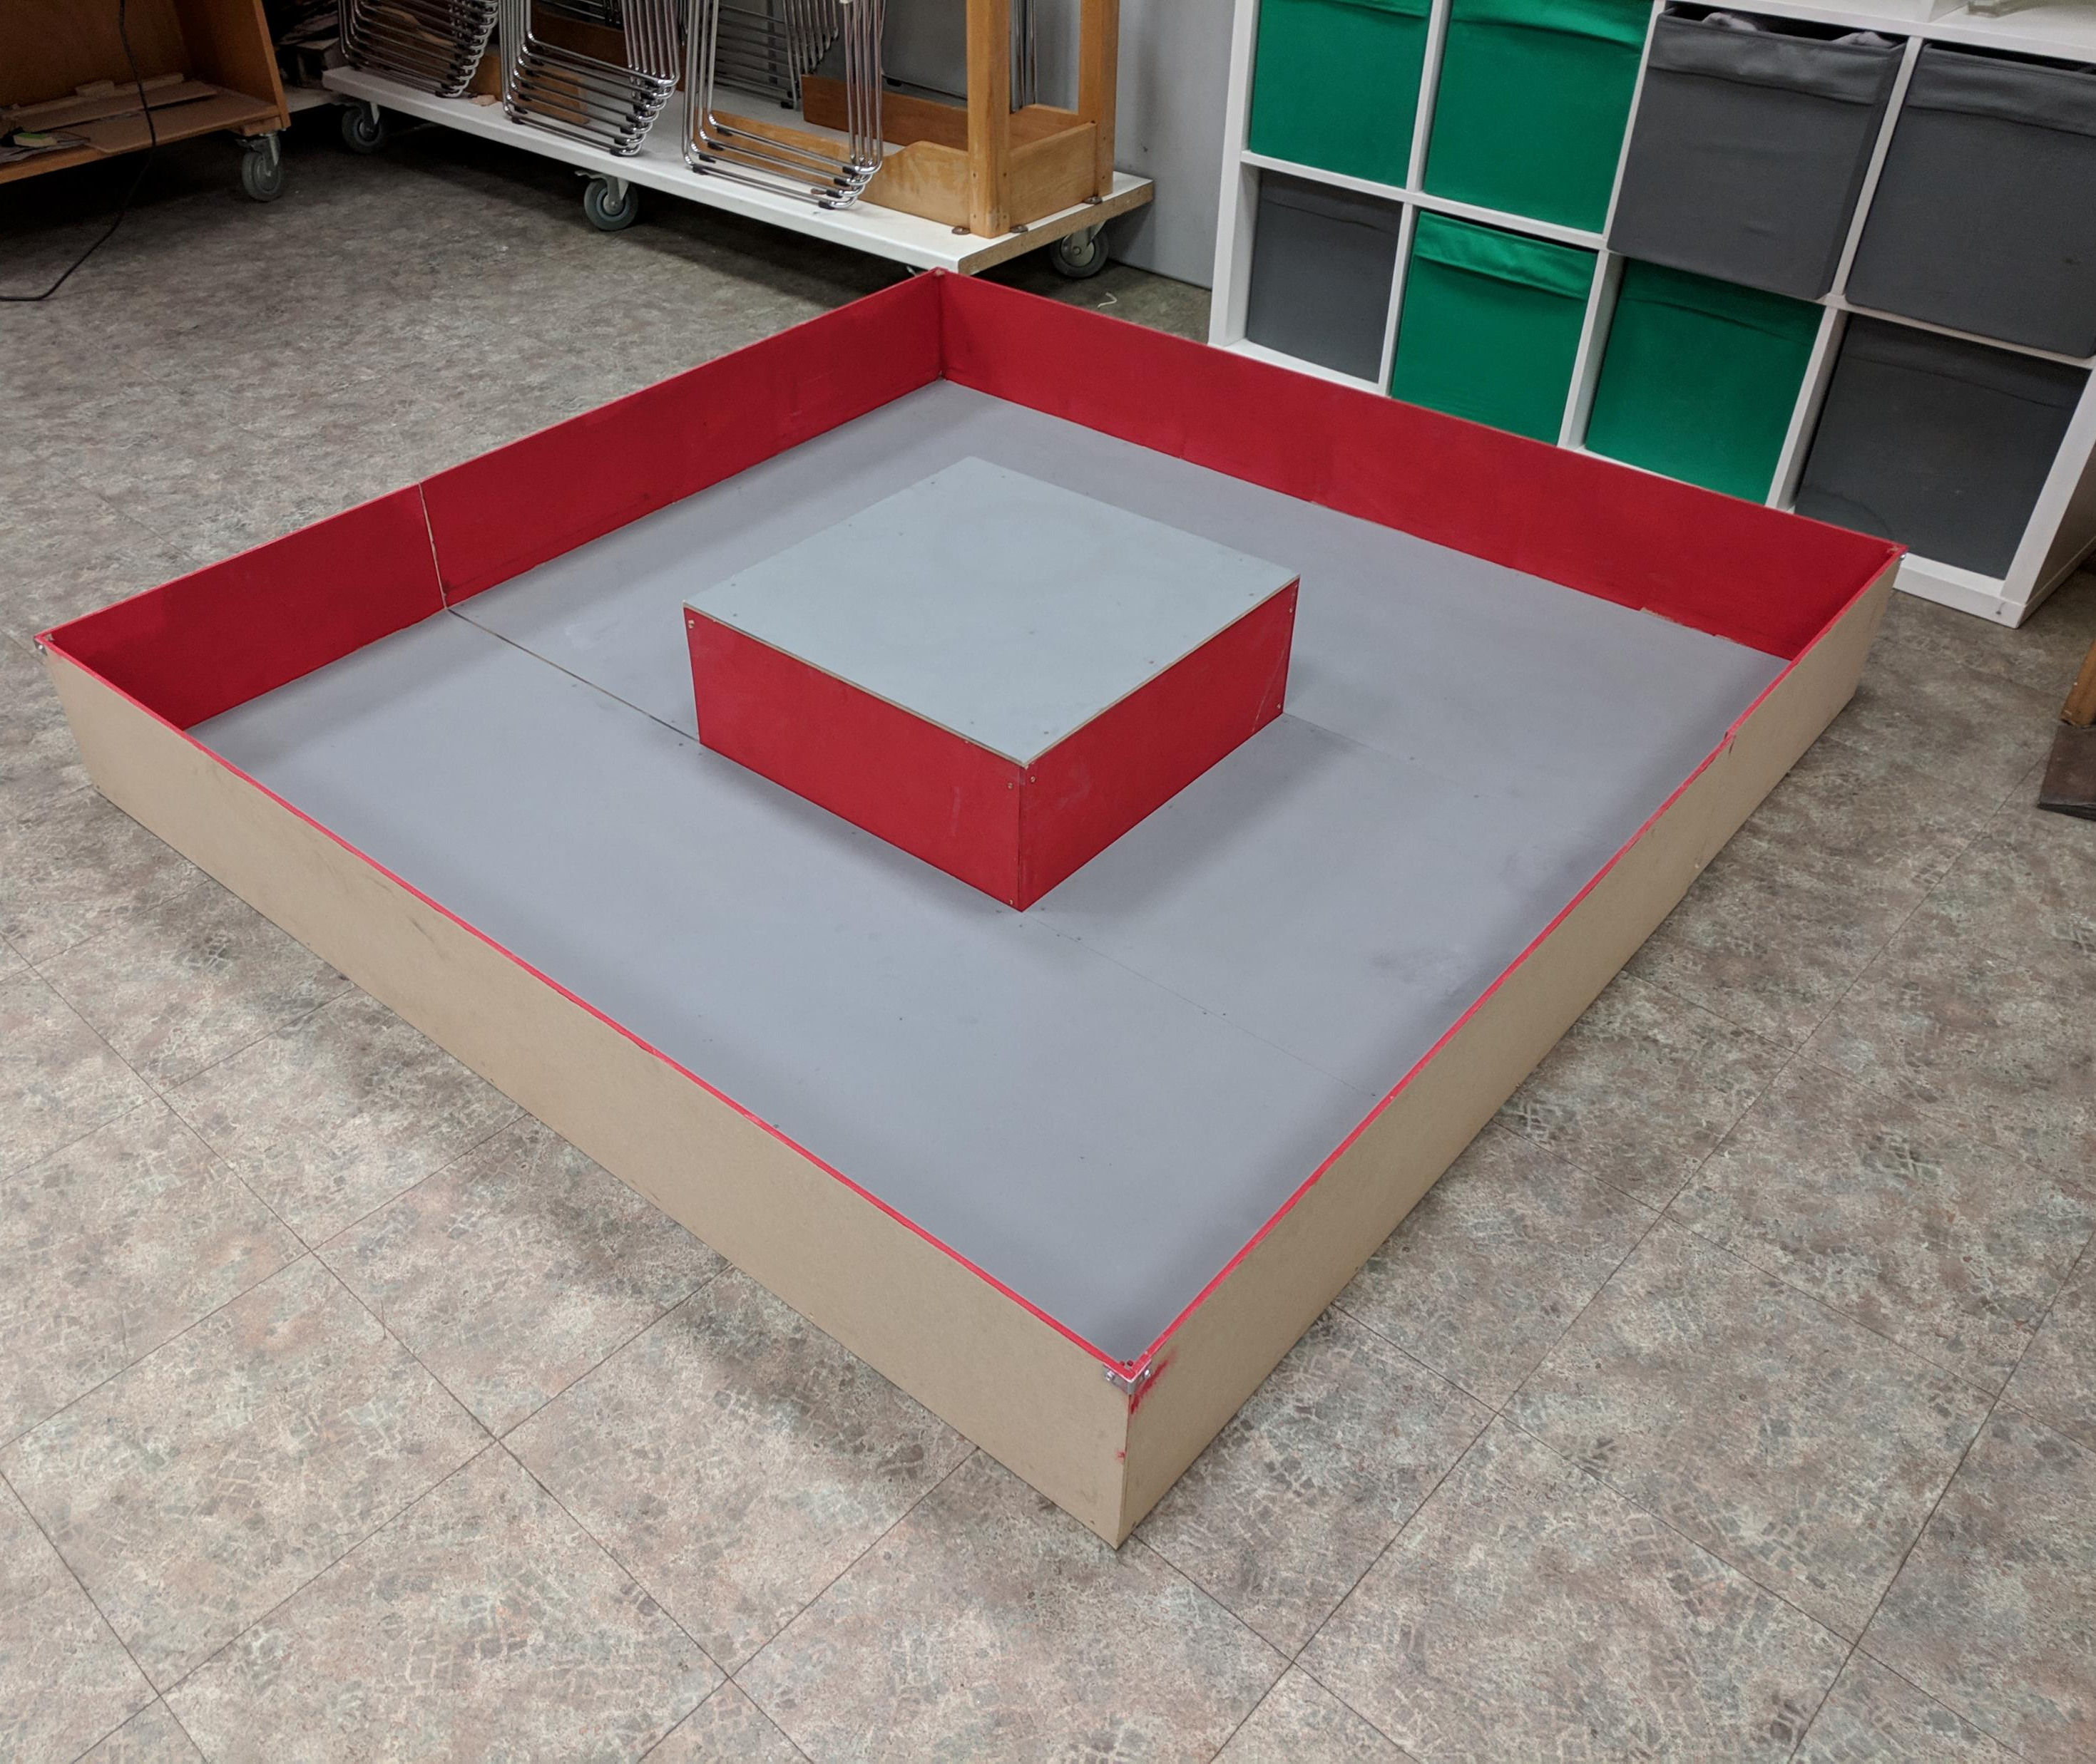
Hints
Bread boards are only for testing new ideas
Aim to finish chassis by start of new year
Build test courses or visit Cambridge Makespace robot club and use ours.
Drive as often as possible
For any CV challenge have a way to calibrate the camera on the day.
Calibrate line following sensors
Have an onboard method to select the running program on robot.

Slide 25
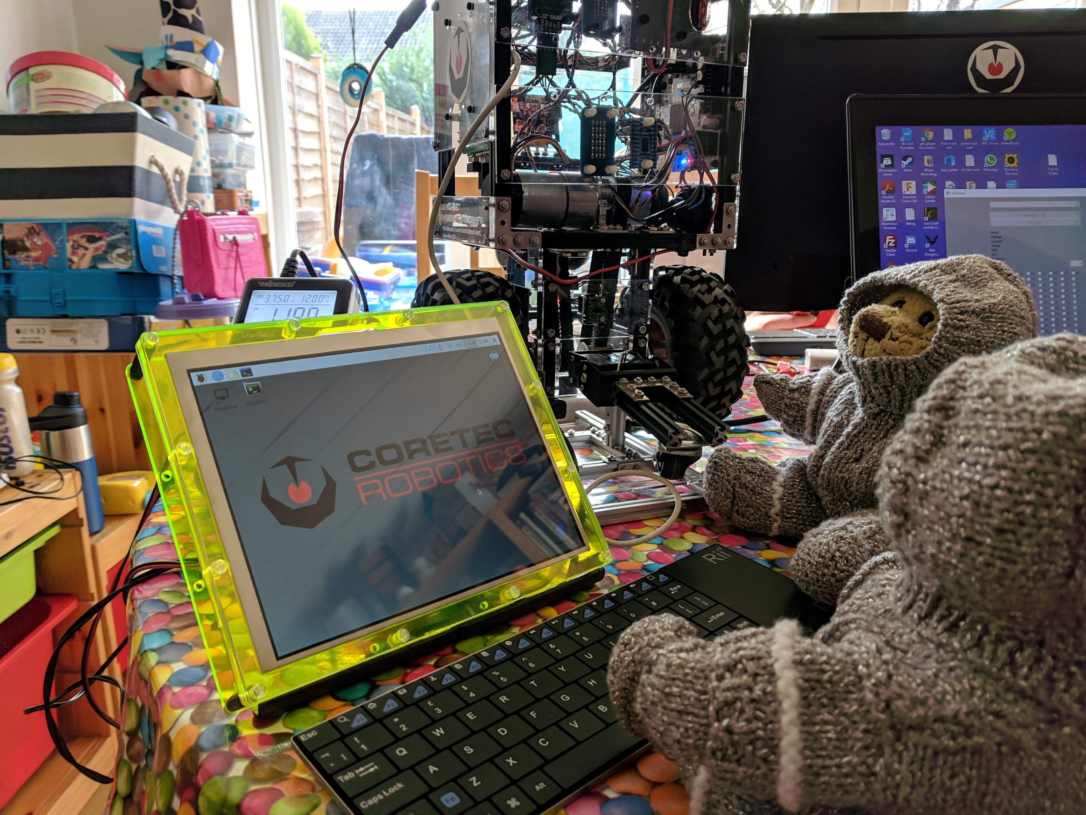
Software
Start early
Drive code first
Build a Menu structure into your code at the start of your programming to select tasks, power down your robot safely
Your interface can just be a single LED and a button.

Slide 26
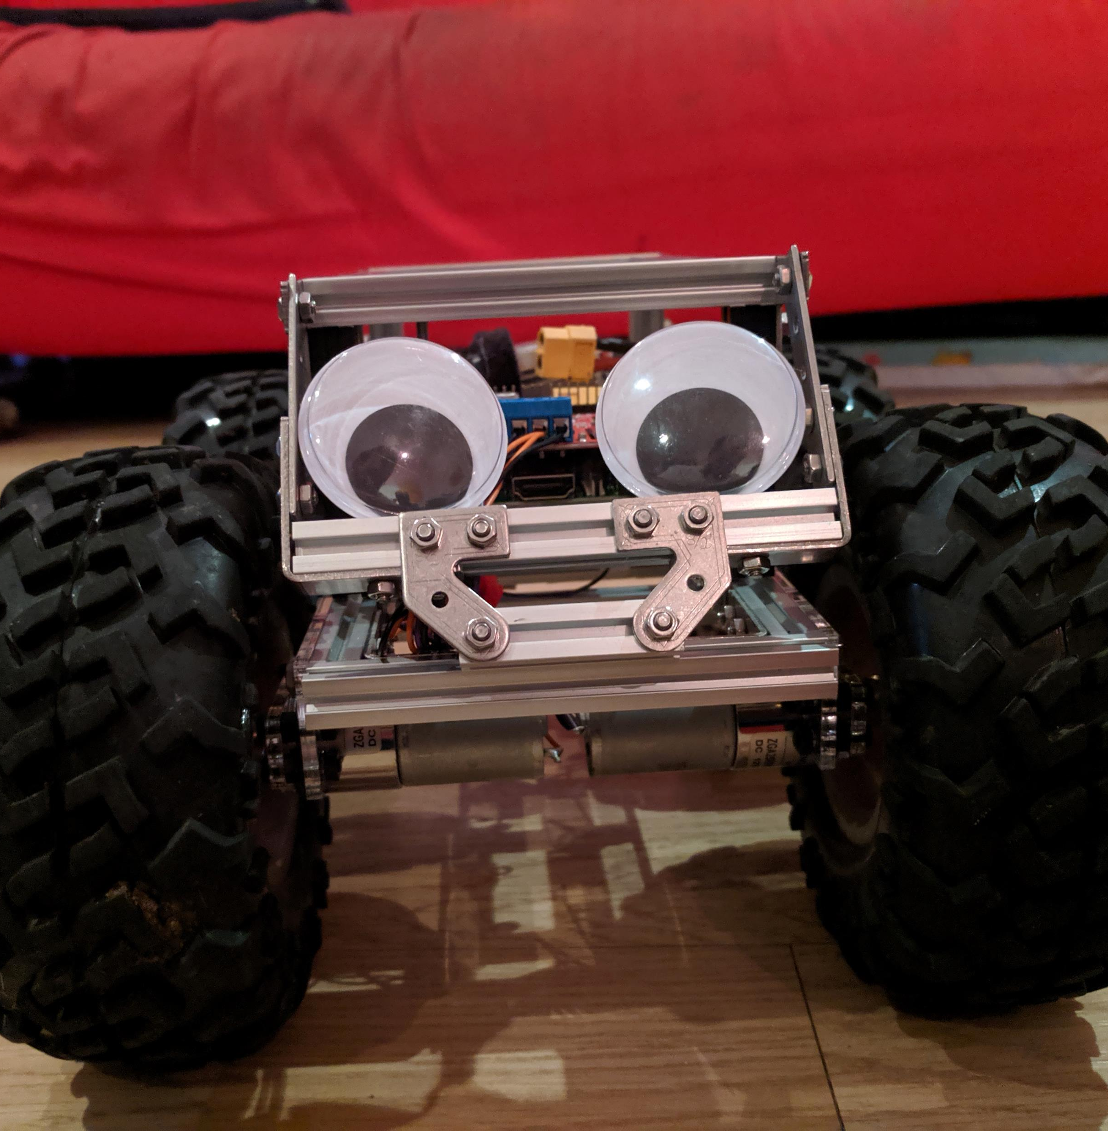
On the day
Have spare batteries already charged for your controller and robot
If you can have spares of key components
Get there early and rested if possible.
If you are a single person team, have somebody supporting you is a great help.
The most important thing is too have fun, having a working robot on the day is a great achievement.

Slide 27
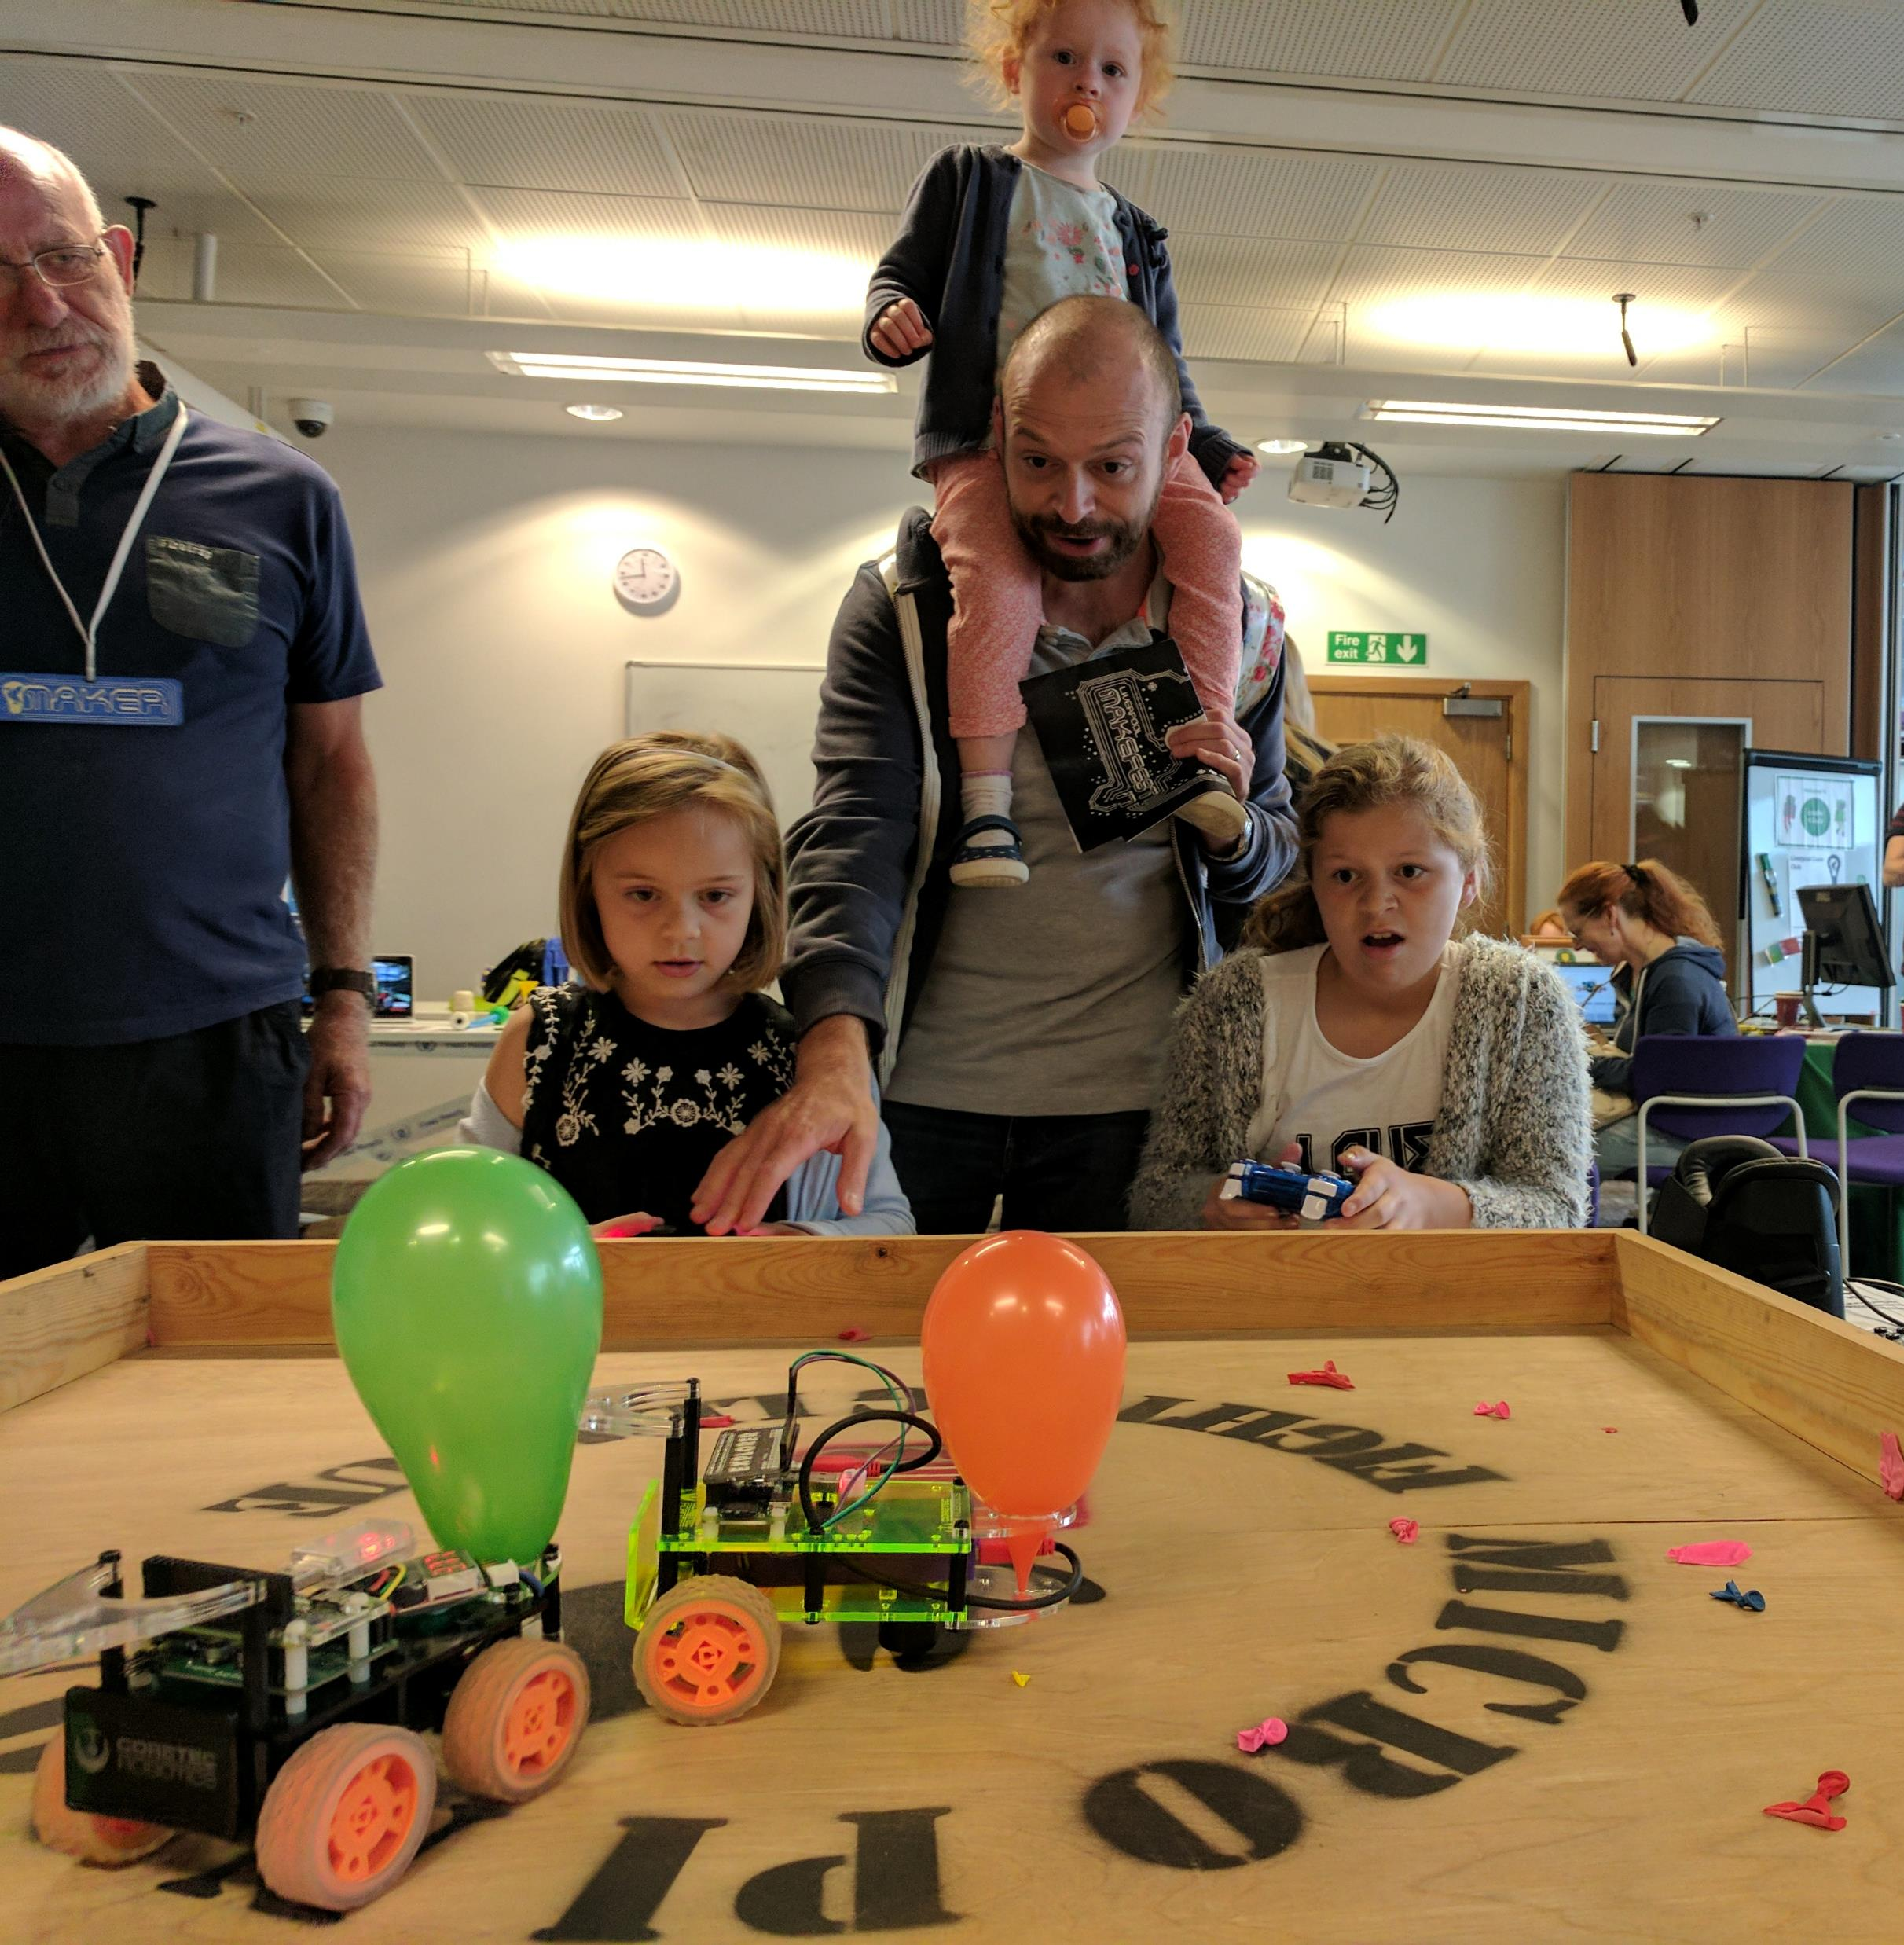
Micro Pi Noon
A6 Balloon popping fighting robots in 1m² arena.

Slide 28
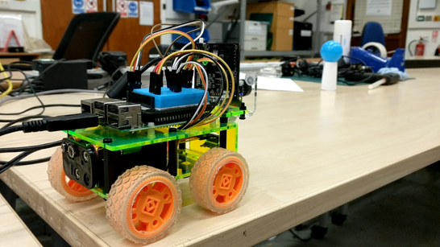
CVzero Making computer vision simple for everyone!
More details can be found at
https://github.com/OpenPiRobotics/CVzero
Hackathon at Cambridge Makespace tomorrow https://www.meetup.com/Makespace/events/264185027/

